Slide 1







10:52
Salt
SHARE-it
Search
How do you like the app?
Categories
Show all
Tools
Technical Devices
Search
Watchlist
Rent
Me

Slide 2
10:52
Salt
SHARE-it
Search
How do you like the app?
Categories
Show all
Tools
Technical Devices
Search
Watchlist
Rent
Me

Slide 3
10:52
Salt
SHARE-it
Search
How do you like the app?
Categories
Show all
Tools
Technical Devices
Search
Watchlist
Rent
Me

Slide 4
10:52
Salt
SHARE-it
Search
How do you like the app?
Categories
Show all
Tools
Technical Devices
Search
Watchlist
Rent
Me

Slide 5
10:52
Salt
SHARE-it
Search
How do you like the app?
Categories
Show all
Tools
Technical Devices
Search
Watchlist
Rent
Me

Slide 6
10:52
Salt
SHARE-it
Search
How do you like the app?
Categories
Show all
Tools
Technical Devices
Search
Watchlist
Rent
Me

Slide 7
Your Watchlist
Articles
Lenders
You have no
saved articles.
Articles that you save are displayed here.

Slide 8

Your Watchlist
Articles
Lenders
You have no
saved lenders.
Lenders that you save are displayed here.

Slide 9

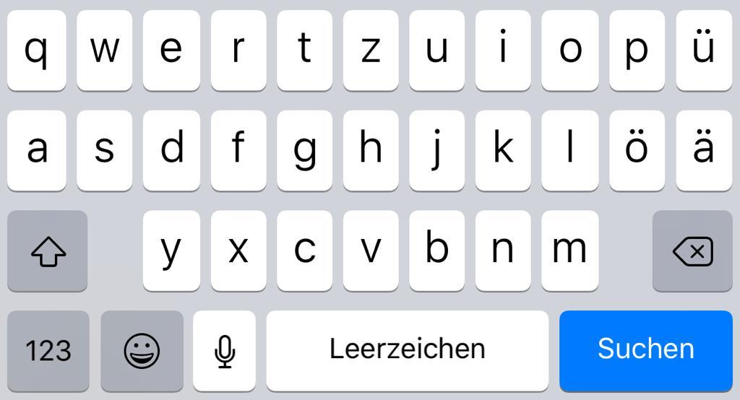
What are you looking for?
Categories
Books
Clothing
Instruments
Movies
Technical Devices
Tools

Slide 10






H
HansM
muster@gmx.ch
My offers
My borrowed things
Borrowed from someone
Questions & answers
Operating instructions

Slide 11
Settings
Account details
Push notifications

Slide 12
Account details
E-mail address
muster@gmx.ch
change
Password
********
change
Language
English
change
Name
Hans Muster
change
Street
16 Xample Street
change
Place
London
change

Slide 13


Push notifications
If my searches return new hits
If the period ends soon
If someone wants to borrow my product
When someone asks a question
If you can borrow something nearby

Slide 14
Push notifications
If my searches return new hits
If the period ends soon
If someone wants to borrow my product
When someone asks a question
If you can borrow something nearby

Slide 15
Push notifications
If my searches return new hits
If the period ends soon
If someone wants to borrow my product
When someone asks a question
If you can borrow something nearby

Slide 16
Push notifications
If my searches return new hits
If the period ends soon
If someone wants to borrow my product
When someone asks a question
If you can borrow something nearby

Slide 17
Push notifications
If my searches return new hits
If the period ends soon
If someone wants to borrow my product
When someone asks a question
If you can borrow something nearby

Slide 18
Push notifications
If my searches return new hits
If the period ends soon
If someone wants to borrow my product
When someone asks a question
If you can borrow something nearby

Slide 19
Post your article
1. Upload photo
upload
2. Titling your product
3. Details about your product
4. Select category
select
5. Deposit amount for the bail
6. Define duration of loan
Publish

Slide 20




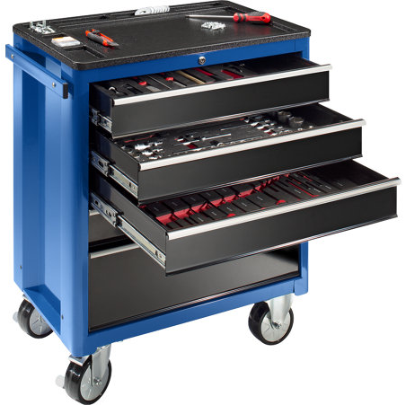
My offers
iMac Retina 5K
Item number: 11125563
Period: 2 weeks
CHF 150
more
Broom
Item number: 11154568
Period: 1 month
CHF 10
more
Tool trolley
Item number: 11186154
Period: 16 weeks
CHF 500
more

Slide 21
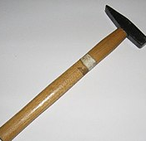
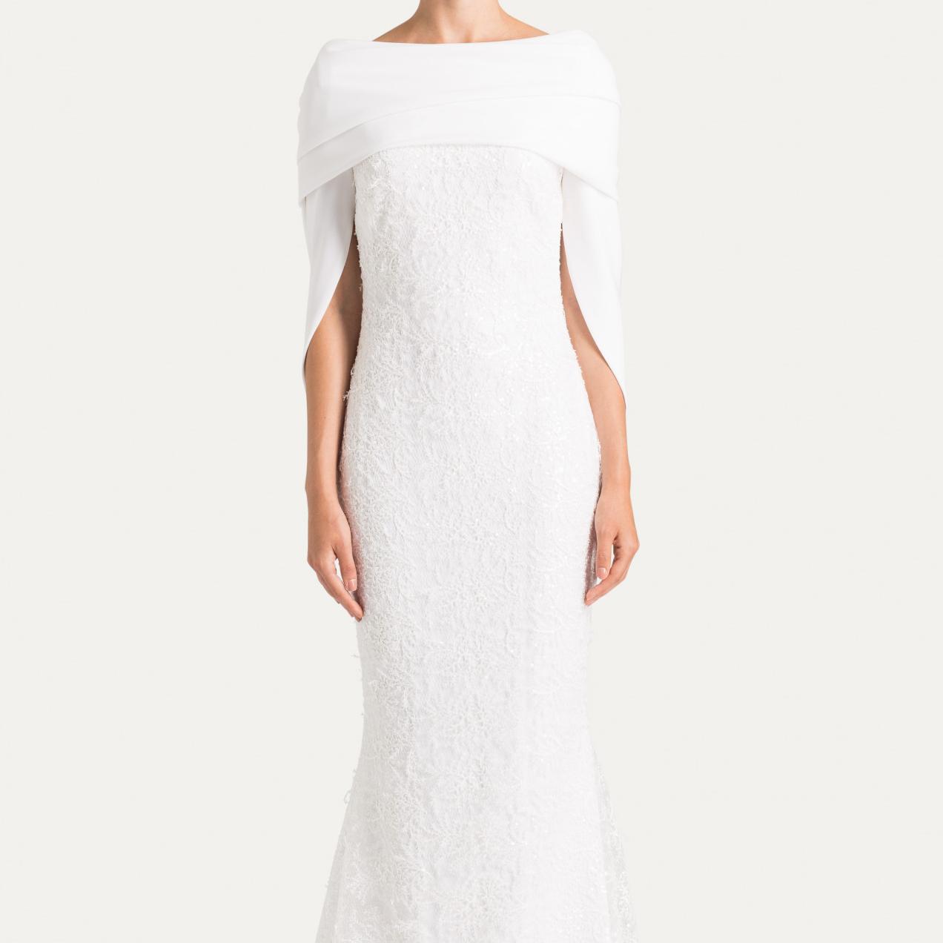
My borrowed things
Hammer
Item number: 11198457
2 days left
CHF 10
more
Wedding Dress
Item number: 11118736
2 months left
CHF 525
more

Slide 22
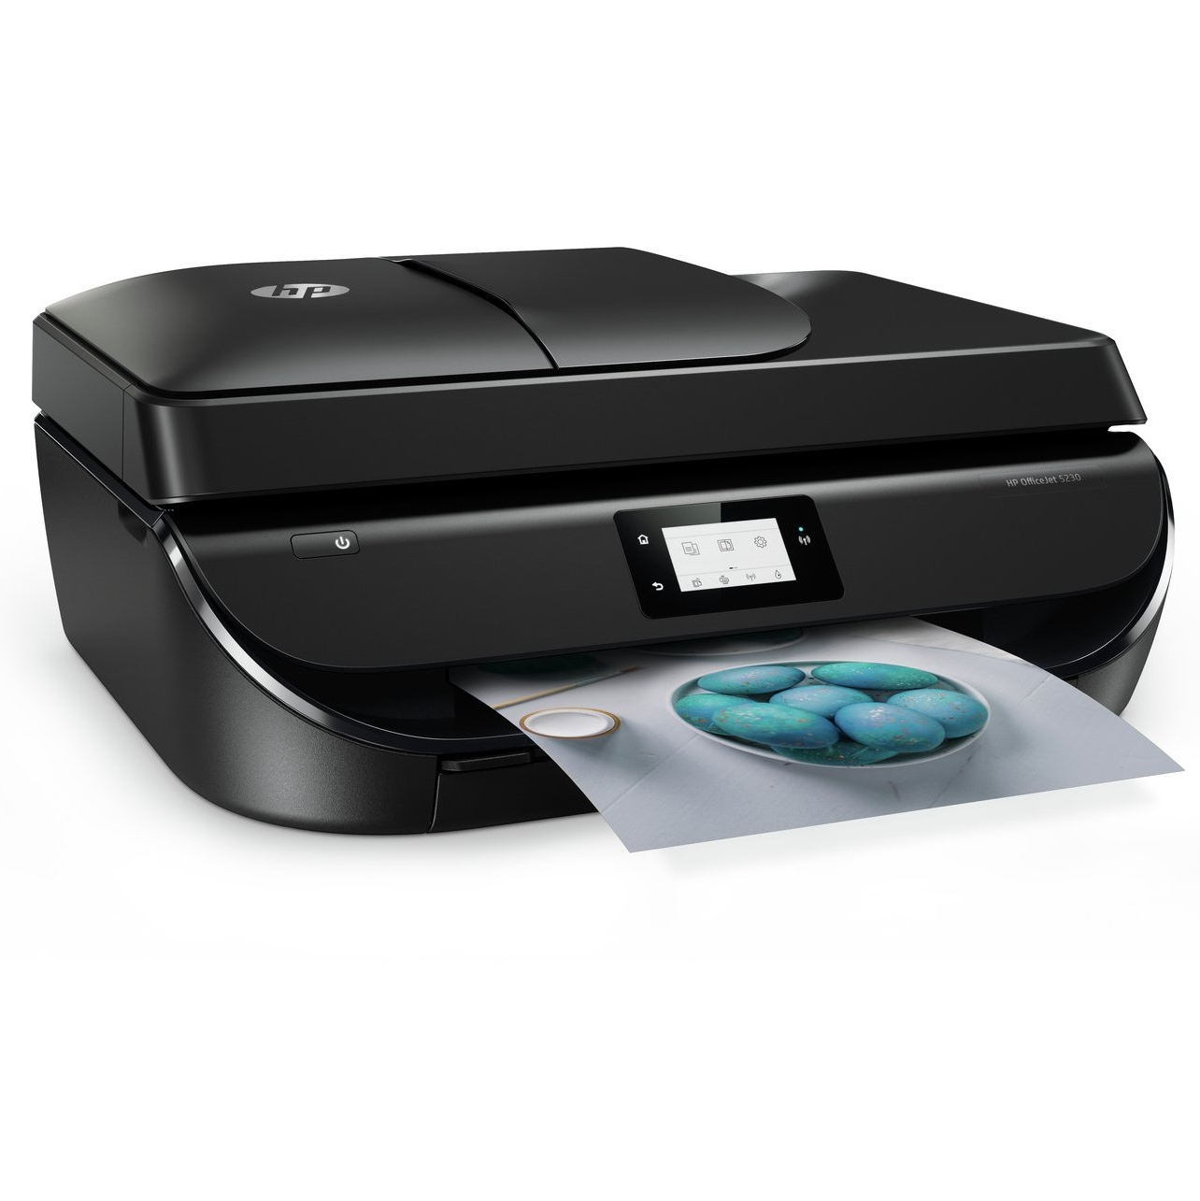
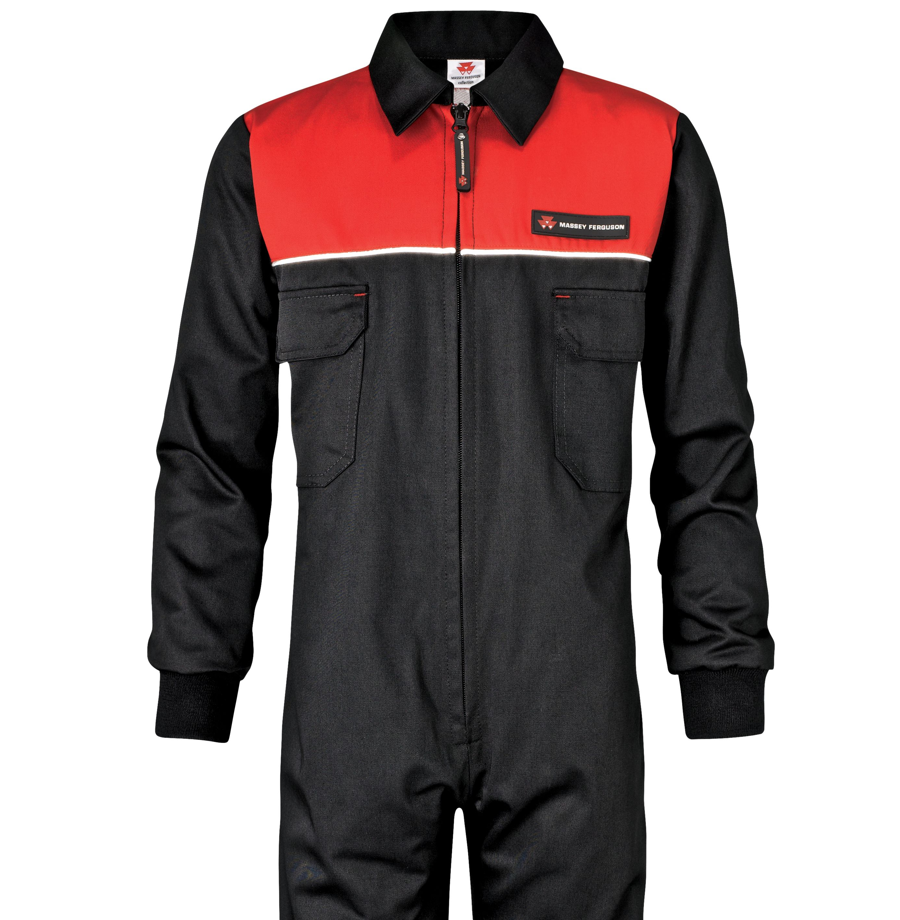
Borrowed
HP-Printer
Item number: 11159342
2 hours left
CHF 70
more
Overall
Item number: 11183125
3 weeks left
CHF 20
more

Slide 23

Questions & Answers
Questions
Answers
You have no
open questions.
Open questions to you will be displayed here.

Slide 24

Questions & Answers
Questions
Answers
You have no
open answers.
Open answers to your questions
are displayed here.

Slide 25
Operating instructions
Goal of this app
With sharing, we can ensure that our planet can recover from the exploitation of raw materials by humans. For young people who don't have a lot of money is this app a good opportunity to borrow things which they prefer and also for free.
Nevertheless, sharing is not a solution for everything! The overpopulation will still remain a big issue. There is no point in sharing everything if the population is growing.
next

Slide 26
Categories
Books
Clothing
Instruments
Movies
Technical Devices
Tools
Toys
Vehicles

Slide 27



Books
If I stay
Item number: 11136478
Period: 1 month
CHF 10
more
The Mamba Mentality
Item number: 11176531
Period: 1 month
CHF 15
more
After
Item number: 11184654
Period: 13 weeks
CHF 9
more

Slide 28
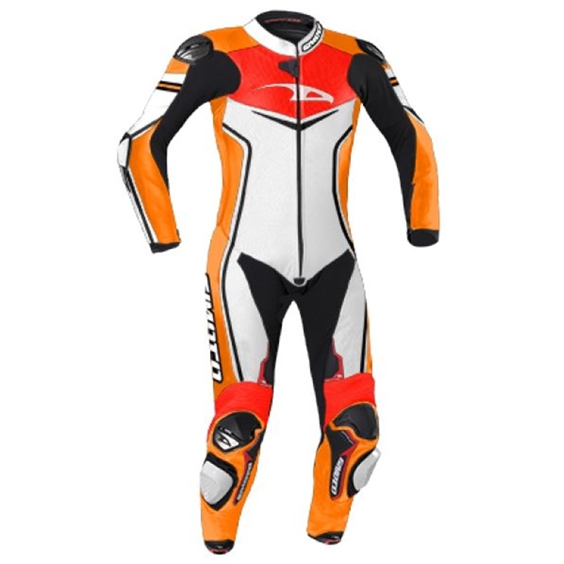
Clothing
Wedding Dress
Item number: 11118736
borrowed
2 months left
CHF 525
more
Overall
Item number: 11183125
Period: 2 months
CHF 20
more
Leather suit Tornado
Item number: 11186156
Period: 5 months
CHF 430
more

Slide 29
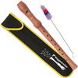
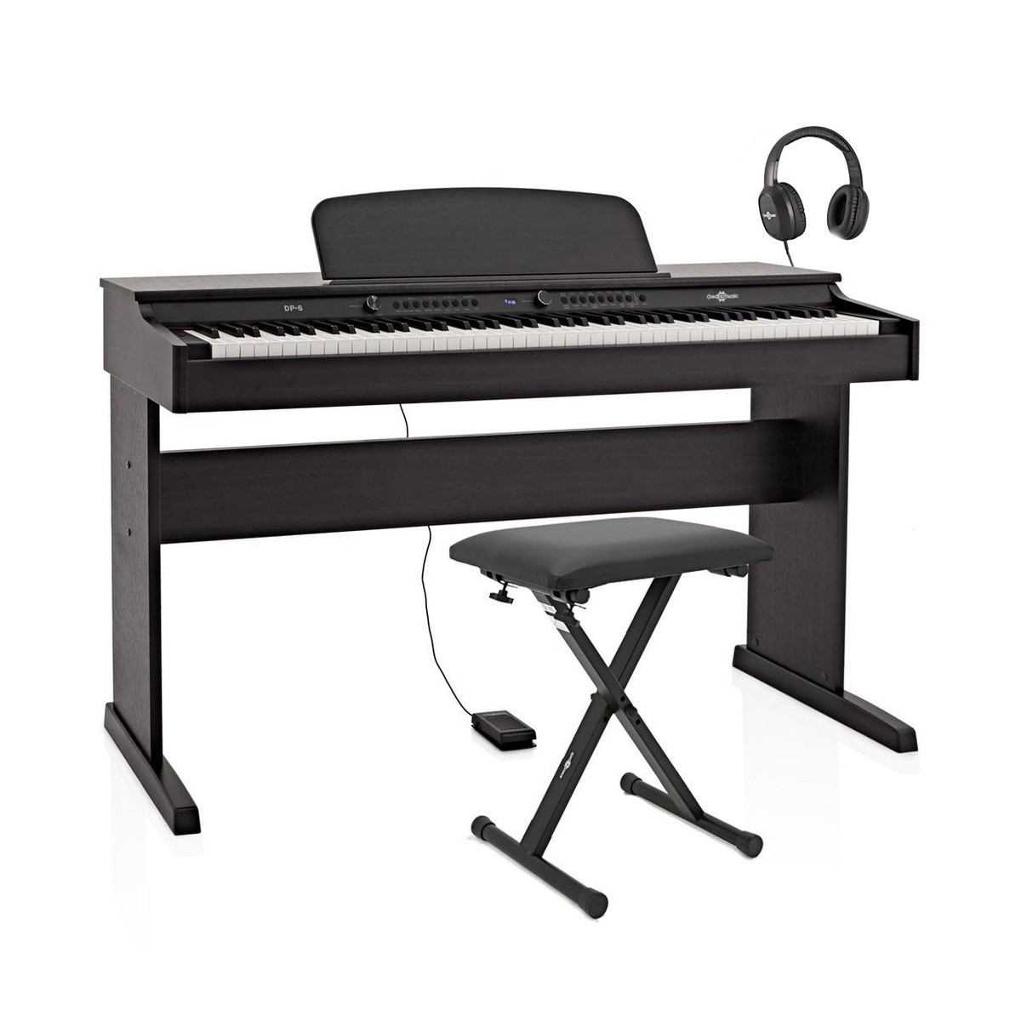
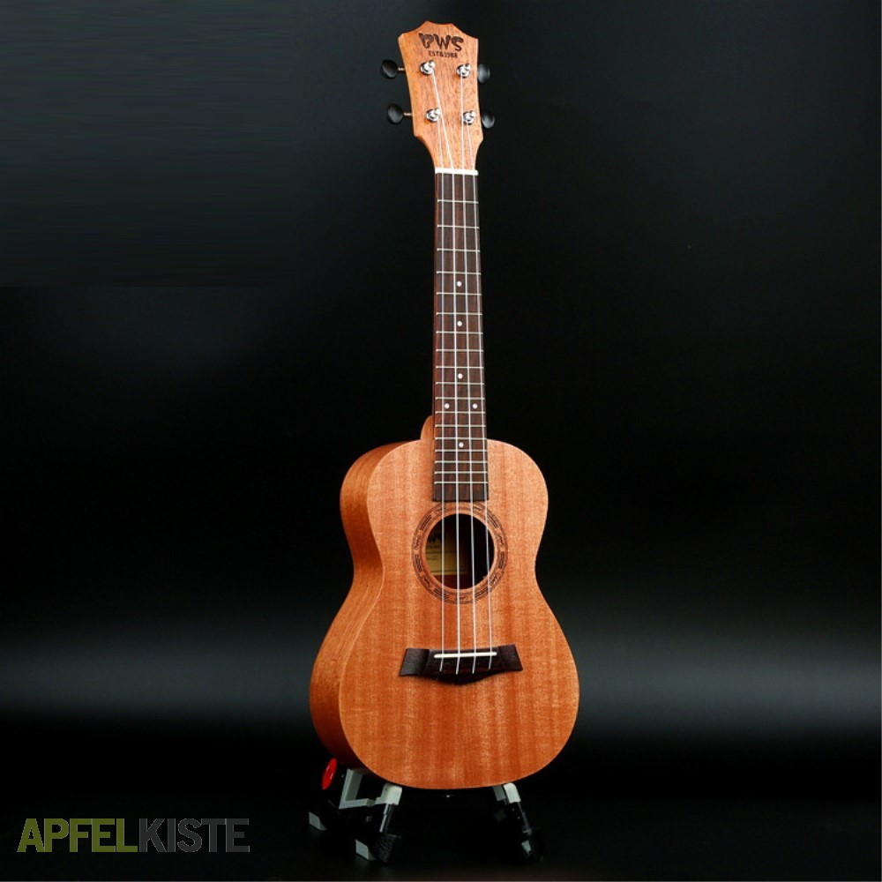
Instruments
Flute
Item number: 11198463
Period: 4 weeks
CHF 60
more
Keyboard
Item number: 11185685
Period: 6 months
CHF 230
more
Guitar
Item number: 11179654
Period: 3 Years
CHF 430
more

Slide 30



Movies
The Gentlemen
Item number: 11157132
Period: 1 month
CHF 10
more
Notting Hill
Item number: 11156378
Period: 2 month
CHF 15
more
Clueless
Item number: 11189648
Period: 14 weeks
CHF 12
more

Slide 31
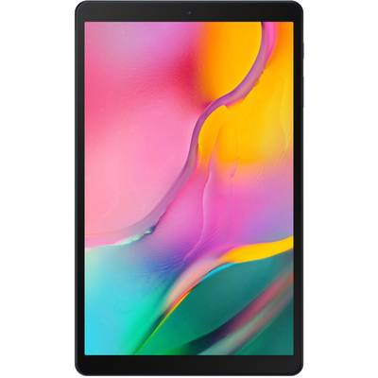
Technical Devices
Samsung Galaxy Tab A
Item number: 11181652
Period: 1 month
CHF 80
more
iMac Retina 5K
Item number: 11125563
Period: 2 weeks
CHF 150
more
HP-Printer
Item number: 11196438
Period: 2 days
CHF 70
more

Slide 32
Tools
Hammer
Item number: 11198457
2 days left
borrowed
CHF 10
more
Broom
Item number: 11154568
Period: 1 month
CHF 10
more
Tool trolley
Item number: 11186154
Period: 16 weeks
CHF 500
more

Slide 33
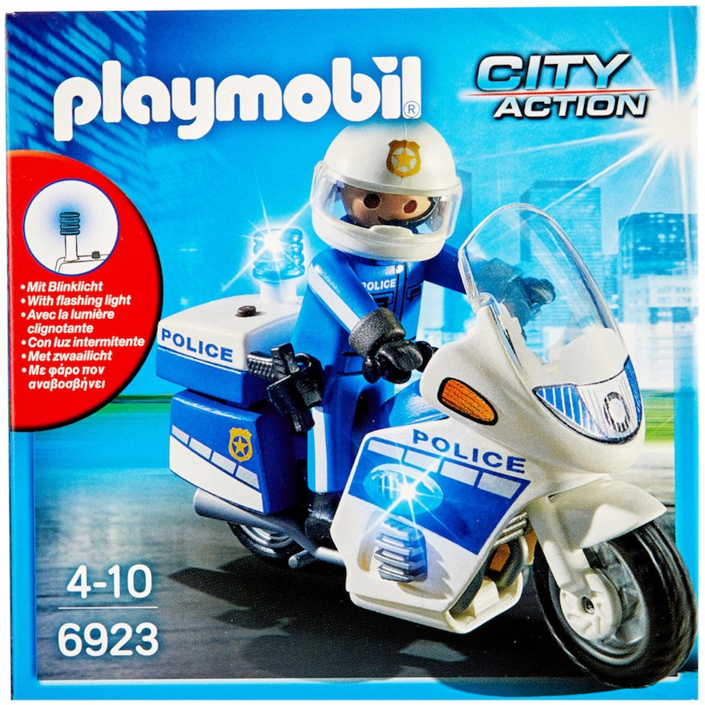
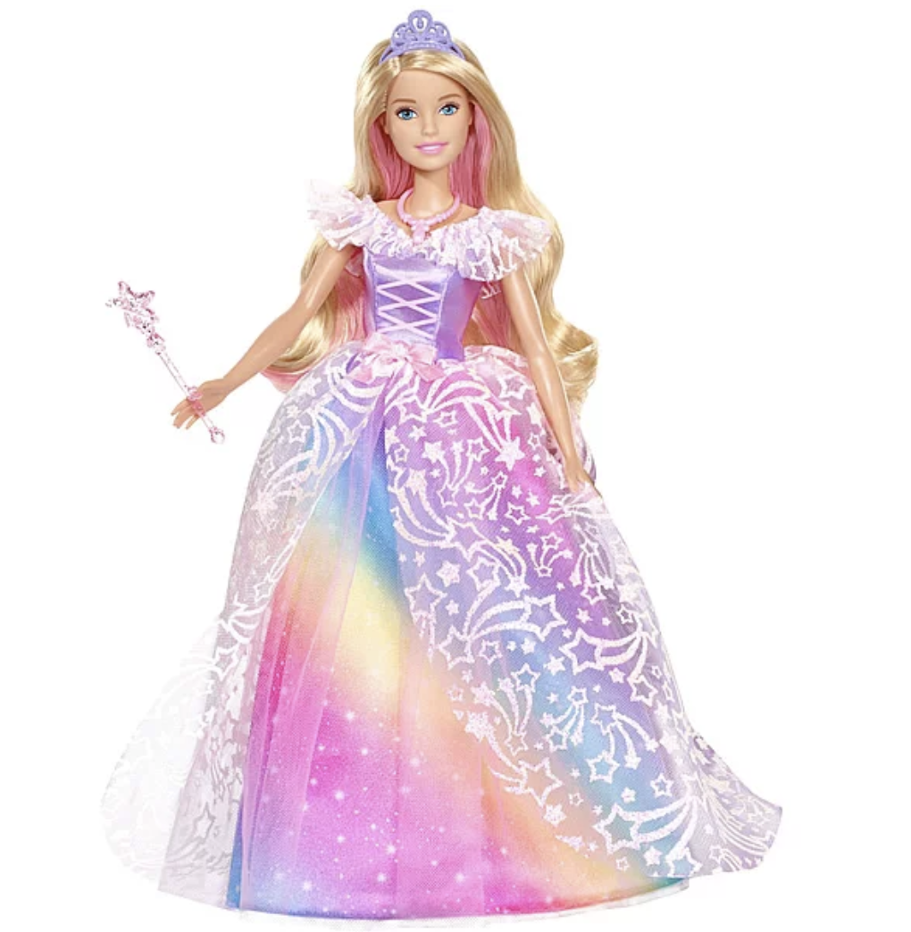

Toys
Playmobil
Item number: 11186163
Period: 3 months
CHF 18
more
Barbie
Item number: 11186193
Period: 6 weeks
CHF 15
more
Lightning McQueen
Item number: 11136745
Period: 10 weeks
CHF 10
more

Slide 34
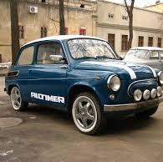
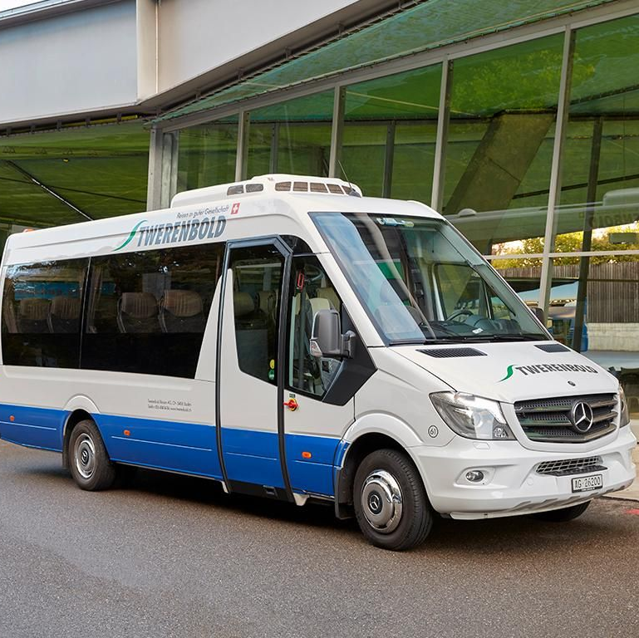
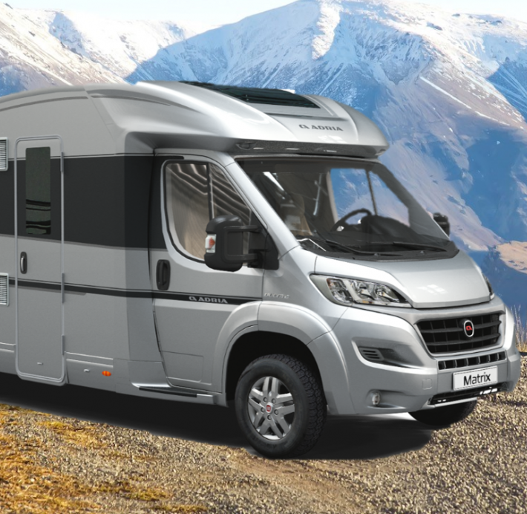
Vehicles
Oldtimer
Item number: 11115798
Period: 2 weeks
CHF 1000
more
Minibus
Item number: 11137925
Period: 6 weeks
CHF 2500
more
Camper
Item number: 11171652
Period: 1 year
CHF 10000
more

Slide 35
If I stay
Item number: 11136478
Period: 1 month
CHF 10
Category: Books
Description:
Author Gayle Forman Page number 320
Date of publication 01.04.2010
Name
Sue Winor
Street
3 Sample Street
Place
London
Mail
sue@gmail.com
Watchlist
Borrow

Slide 36
The Mamba Mentality
Item number: 11176531
Period: 1 month
CHF 15
Category: Books
Description:
Author Kobe Bryant Page number 208
Date of publication 23.01.2019
Name
Walter Smith
Street
4 Londonstreet
Place
London
Mail
walter@wwt.ch
Watchlist
Borrow

Slide 37
After
Item number: 11184654
Period: 13 weeks
CHF 9
Category: Books
Description:
Author Anna Todd Page number 592
Date of publication 21.10.2014
Name
Joe Lenard
Street
Rue de la gare 3
Place
France
Mail
joe@bluewin.ch
Watchlist
Borrow

Slide 38
Wedding Dress
Item number: 11118736
2 months left
CHF 525
borrowed
Category: Clothing
Description:
Size EU 38
Material chiffon, lace
Colour off-white
Name
Susan Leroid
Street
5 Oxefordstreet
Place
London
Mail
susan@bluewin.ch
Watchlist
Borrow

Slide 39
Overall
Item number: 11183125
Period: 2 months
CHF 20
Category: Clothing
Description:
This overall is very confortable and good for working.
Name
Paul Miller
Street
15 Streetfew
Place
London
Mail
paul@ccb.com
Watchlist
Borrow

Slide 40
Leather suit Tornado
Item number: 11186156
Period: 5 months
CHF 430
Category: Clothing
Description:
Leather suit with knee and elbow pads and a pleasant sitting feeling on the motorcycle.
Name
Nick Brown
Street
5 Mercer Walk
Place
London
Mail
nick@bluewin.com
Watchlist
Borrow

Slide 41
Flute
Item number: 11198463
Period: 4 weeks
CHF 60
Category: Instruments
Description:
The classic! This warm sounding wooden recorder is made of crack resistant sycamore maple.
Name
Jasper Davis
Street
44 Lincoln’s Inn Fields
Place
London
Mail
jasper@bluewin.com
Watchlist
Borrow

Slide 42
Keyboard
Item number: 11185685
Period: 6 months
CHF 230
Category: Instruments
Description:
The keyboard is a digital piano with 88 weighted plastic keys and a
64-note polyphony.
Name
Simon Tremblay
Street
11 Pilgrim
Place
London
Mail
simon@bbc.uk.com
Watchlist
Borrow

Slide 43
Guitar
Item number: 11179654
Period: 3 Years
CHF 430
Category: Instruments
Description:
The guitar is made of fine wood with nylon strings. The instrument produces great sounds.
Name
Martin Taylor
Street
Broadgate West II
Place
London
Mail
taylor@ttl.uk.com
Watchlist
Borrow

Slide 44
The Gentlemen
Item number: 11157132
Period: 1 month
CHF 10
Category: Movies
Description:
Director Guy Ritchie Genre Thriller/Action
Date of publication 01.01.2020
Name
Angus Rodriguez
Street
Waterhouse Square
Place
London
Mail
angus@ttl.uk.com
Watchlist
Borrow

Slide 45
Notting Hill
Item number: 11156378
Period: 2 month
CHF 15
Category: Movies
Description:
Director Roger Michell Genre Drama
Date of publication 09.07.1999
Name
Frank O'Neill
Street
Barbican
Place
London
Mail
frank@clb.uk.com
Watchlist
Borrow

Slide 46
Clueless
Item number: 11189648
Period: 14 weeks
CHF 12
Category: Movies
Description:
Director Amy Heckerling Genre Drama
Date of publication 16.02.1996
Name
Emma Jones
Street
Barbican
Place
London
Mail
emma@gmail.com
Watchlist
Borrow

Slide 47
Samsung Galaxy Tab A
Item number: 11181652
Period: 1 month
CHF 80
Category: Devices
Description:
Screen size 10.10 customs Back-Camera 8 MP
Memory 32 GB
Name
Zoe Anderson
Street
31 Austin
Place
London
Mail
zoe@uk.uk.com
Watchlist
Borrow

Slide 48
iMac Retina 5K
Item number: 11125563
Period: 2 weeks
CHF 150
Category: Devices
Description:
Screen size 68.58 cm Processor Intel Core i5 Memory Type Fusion Drive 1TB
Name
Hans Muster
Street
16 Xample Street
Place
London
Mail
muster@gmx.ch
Watchlist
Borrow

Slide 49
HP-Printer
Item number: 11196438
Period: 2 days
CHF 70
Category: Devices
Description:
Thanks to the possibility to print easily via mobile devices, the printer simplifies the daily tasks.
Name
Glenn Davies
Street
Invalides
Place
Paris
Mail
glenn@gmail.com
Watchlist
Borrow

Slide 50
Hammer
Item number: 11198457
2 days left
CHF 10
borrowed
Category: Tools
Description:
The normal hammer is perfect for everyday use. Hanging pictures now works without problems.
Name
Lian Murphy
Street
Necker
Place
Paris
Mail
lian@bluewin.ch
Watchlist
Borrow

Slide 51
Broom
Item number: 11154568
Period: 1 month
CHF 10
Category: Tools
Description:
The broom is perfect for keeping the household clean. Cleanliness is essential!
Name
Hans Muster
Street
16 Xample Street
Place
London
Mail
muster@gmx.ch
Watchlist
Borrow

Slide 52
Tool trolley
Item number: 11186154
Period: 16 weeks
CHF 500
Category: Tools
Description:
The robust trolley tool case is the perfect all-round talent for all applications in and around the house.
Name
Hans Muster
Street
16 Xample Street
Place
London
Mail
muster@gmx.ch
Watchlist
Borrow

Slide 53
Playmobil
Item number: 11186163
Period: 3 months
CHF 18
Category: Toys
Description:
Playmobil is fun for young and old. You can let your creativity run free.
Name
Heaven Mitchell
Street
Quartiere XX
Place
Rom
Mail
heaven@gmail.com
Watchlist
Borrow

Slide 54
Barbie
Item number: 11186193
Period: 6 weeks
CHF 15
Category: Toys
Description:
Barbie – the wish of every little girl! The Barbie Dreamtopia ball gown princess fires the imagination of kids.
Name
John Johnson
Street
Uccle
Place
Bruxelles
Mail
john@gmail.com
Watchlist
Borrow

Slide 55
Lightning McQueen
Item number: 11136745
Period: 10 weeks
CHF 10
Category: Toys
Description:
The toy car with 2-channel radio remote control can do almost as many tricks as the film model.
Name
Lian Patel
Street
Geetbets
Place
Bruxelles
Mail
lian@gmail.com
Watchlist
Borrow

Slide 56
Oldtimer
Item number: 11115798
Period: 2 weeks
CHF 1000
Category: Vehicles
Description:
The MINI Cooper with airbag and root wood equipment in professionally restored condition.
Name
Edgar Lewis
Street
Borough of Camden
Place
London
Mail
edgar@gmail.uk.com
Watchlist
Borrow

Slide 57
Minibus
Item number: 11137925
Period: 6 weeks
CHF 2500
Category: Vehicles
Description:
A vehicle with comfort chassis, automat, extra-long with nine seats.
Name
Richard Hughes
Street
Walworth
Place
London
Mail
richard@hht.uk.com
Watchlist
Borrow

Slide 58
Camper
Item number: 11171652
Period: 1 year
CHF 10000
Category: Vehicles
Description:
The camper is perfectly equipped with plates and two double beds as well as kitchen and toilette.
Name
Max Moore
Street
15 Old Town
Place
London
Mail
max@zzq.uk.com
Watchlist
Borrow

Slide 59
Operating instructions
How you use this app
If you are looking for certain items, you can enter the name of the product on the start page under search.
The borrowing is free of charge. The displayed price is only a deposit. If you return the item to the lender, you will get your money back in return.
The time limit shows you the maximum time you are allowed to own the item. This period can be viewed individually with the lender.
back
next

Slide 60
Operating instructions
How you use this app
Of course you can also lend things yourself. You can go to the icon rent and enter your item there. It will be sent to the SHARE-it team for approval.
To use the app, you have to register for free. Your e-mail address will not be used for advertising purposes and will be used to contact you.
back

