Slide 1

Cosmetics
History
Today
Harmful Ingredients
Organic Trend
Question

Slide 2
History
Ancient World (Egypt & Greece)
  Health / Hygiene / Protection / Beauty
  Oils / Minerals / Honey / Plants / Salts
  ALL NATURAL
New World (Early 1900s)
  Prostitutes / Theater / Ballet / Film Industry / Rich people
  Actual paint / Burnt matchsticks / Petroleum / Alcohol
  BECOMING TOXIC

Slide 3
Today
Everybody / Everyday / Everywhere
Main Ingredients:
  Petroleum / Palm Oil
  Parabens
  Fragrances
  Emulsifiers
  Aluminum
  Microplastics
  Sulfates
  Animal Ingredients
  Water
  Minerals

Slide 4
Harmful Ingredients
Humans
  Hormonally Effective (Diabetes / Cancer / Infertility)
  Diseases / Skin Vulnerability
Animals
  Animal Testing
  Infested Living Space
  Used as Ingredients
Environment
  Pollution
  Manufacturing / Mining

Slide 5
Organic Trend
Healthy Ingredients
Recycled packaging
Vegan Products
Eco Friendly Mining / Manufacturing
Lush
Code Check App

Slide 6
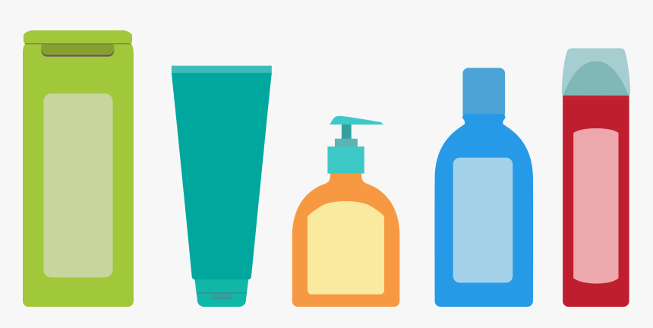
Which shampoo contains the least harmful ingredients?
Aqua / Water, Sodium Laureth Sulfate, Dimethicone, Sodium Chloride, Coco-Betaine, Glycol Distearate, Ci 19140 / Yellow 5, Ci15985 / Yellow 6, Guar Hydroxypropyltrimonium Chloride, Niacinamide, Cocamide Mipa, Saccharum Officinarum Extract / Sugarcaneextract, Sodium Benzoate, Sodium Cocoate, Sodium Hydroxide, Olea Europaea Oil / Olive Fruit Oil, Salicylic Acid, Camelliasinensis Extract / Camellia Sinensis Leaf Extract, Linalool, Benzyl Salicylate, Pyrus Malus Extract / Apple Fruit Extract, Carbomer, Pyridoxine Hcl, Persea Gratissima Oil / Avocado Oil, Citric Acid, Butylphenyl Methylpropional, Methyl Cocoate, Butyrospermum Parkii Butter / Shea Butter, Citrus Medica Limonum Peel Extract / Lemon Peel Extract, Hexylene Glycol, Hexylcinnamal, Parfum / Fragrance.
Aqua, sodium coco-sulfate, coco-glucoside, citric acid, sodium chloride, hydrolyzed wheat protein, glyceryl oleate, parfum, sodium benzoate, decyl glucoside, dicaprylyl ether, potassium sorbate, butylene glycol, helianthus annuus seed extract, limonene, sodium hydroxide, benzoic acid, tocopherol, hydrogenated palm glycerides citrate, lecithin, ascorbyl palmitate
Aqua (Water, Eau), Sodium C14-16 Olefin Sulfonate, Cocamidopropyl Betaine, Sodium Methyl Cocoyl Taurate, PEG-120 Methyl Glucose Dioleate, Sodium Chloride, Parfum (Fragrance), Persea Gratissima (Avocado) Oil, Guar Hydroxypropyltrimonium Chloride, Panthenol, Citric Acid, Sodium Benzoate, PEG-7 Glyceryl Cocoate, PEG-40 Hydrogenated Castor Oil, Coconut Acid, Propylene Glycol

Slide 7
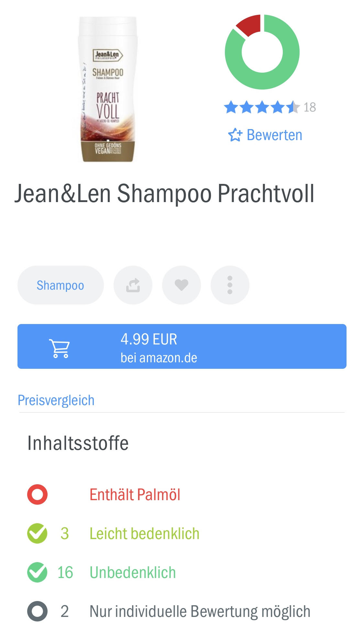
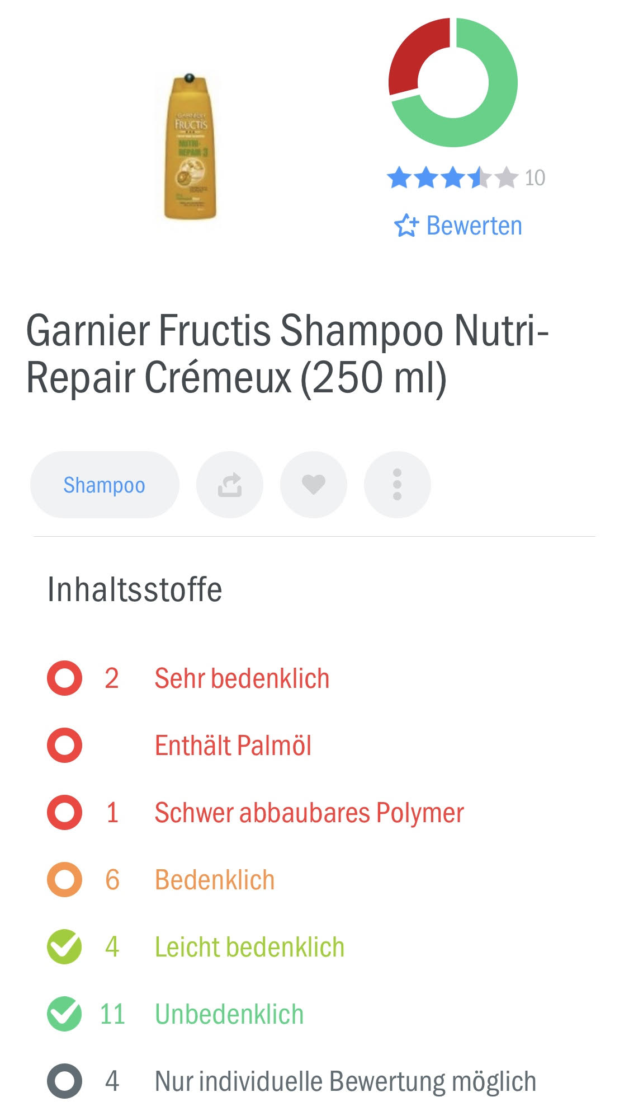
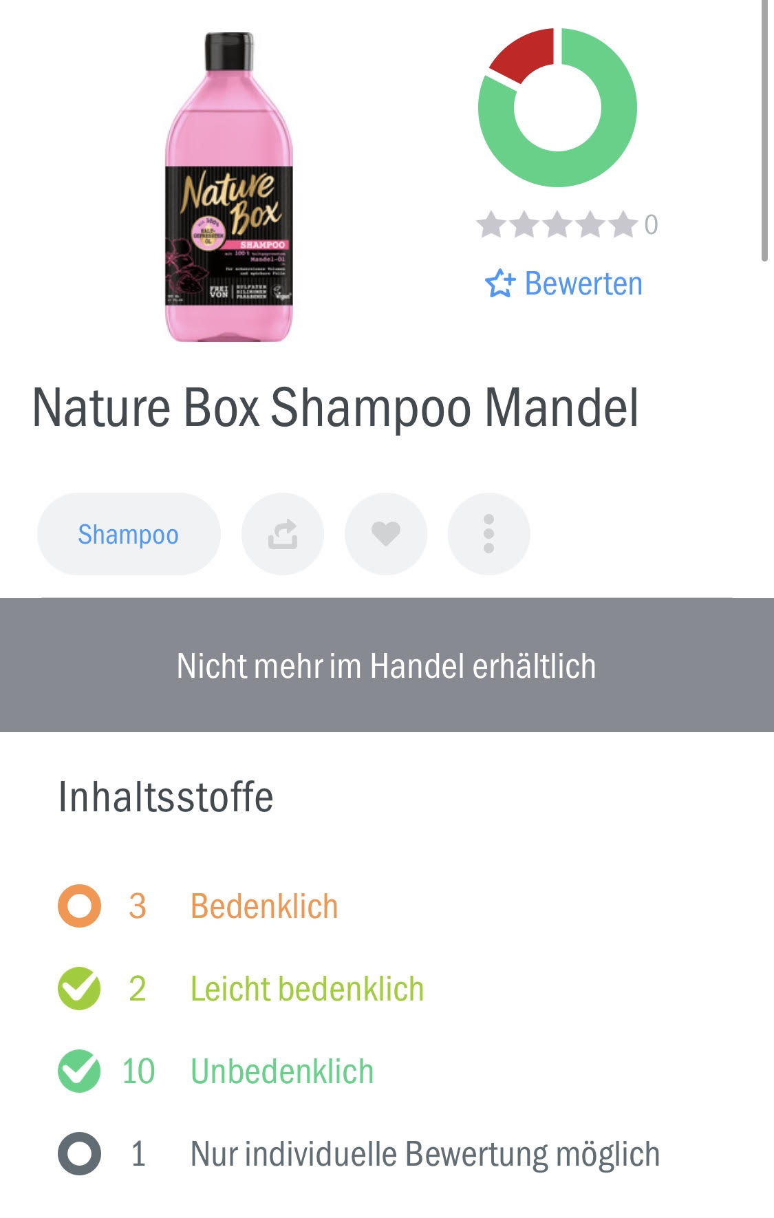
The Blue One!

