Slide 1
Electronicwaste
Dominic & Giorgio

Slide 2
Content
Definition
Electronic waste worldwide
Recycling
Problems
Question
Sources

Slide 3
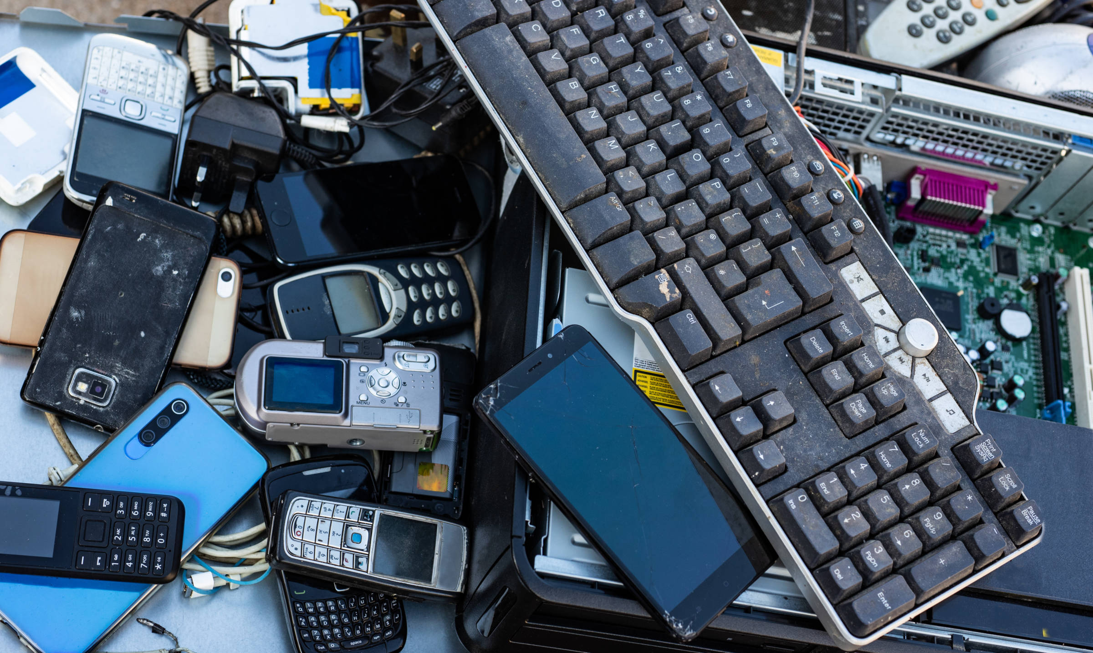
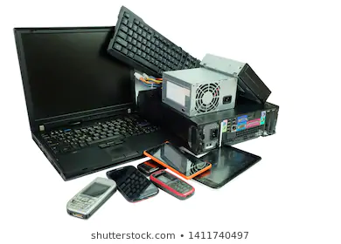
Definition
Used electronics which are destined for:
  refurbishment
  reuse
  Resale
  recycling through material recovery

Slide 4
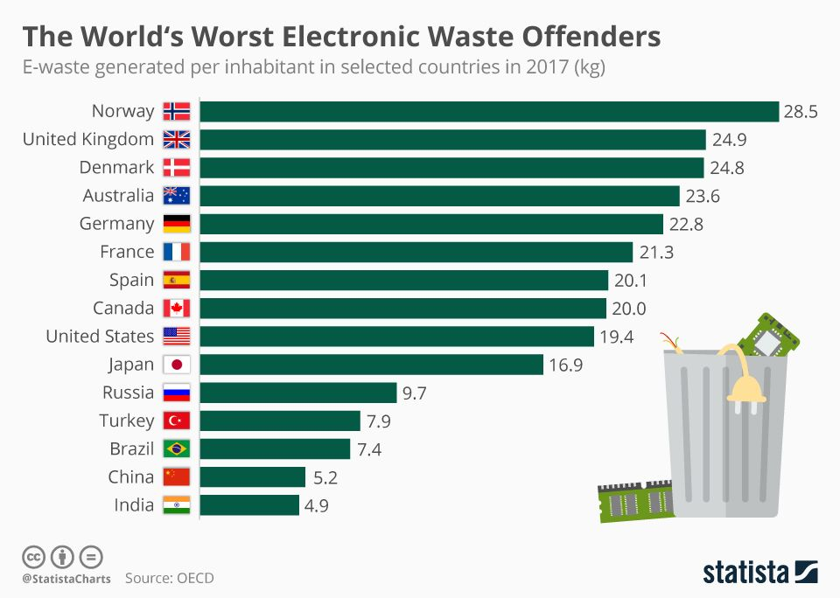
Electronic waste worldwide

Slide 5
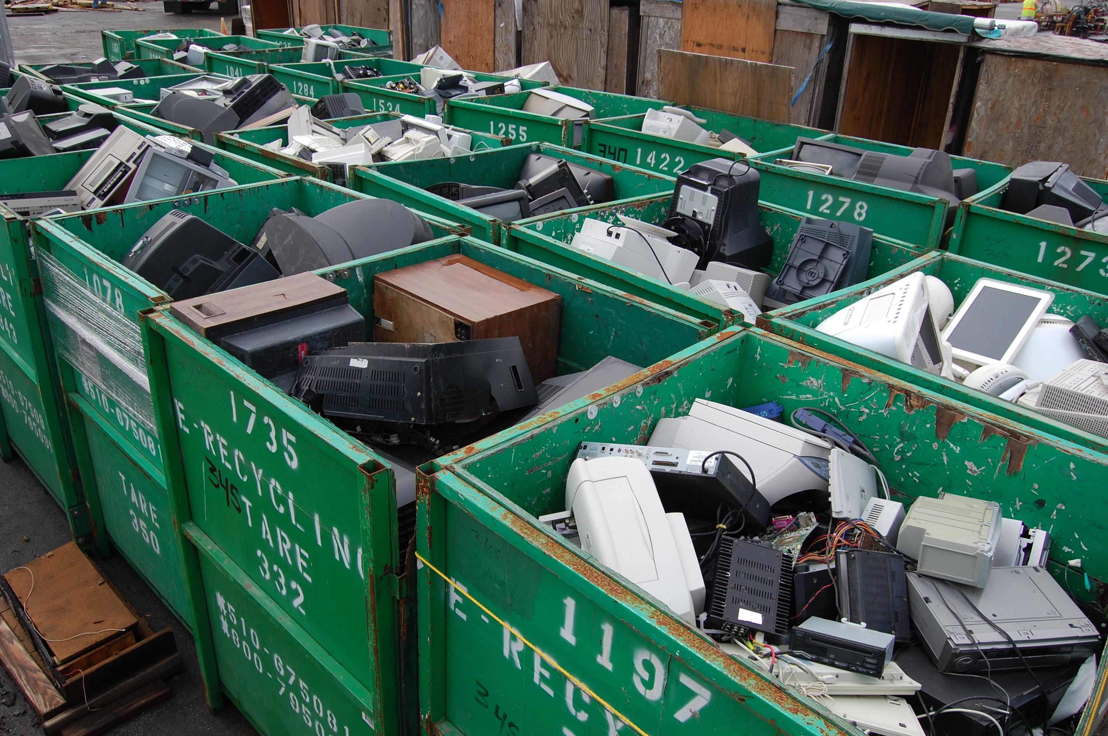
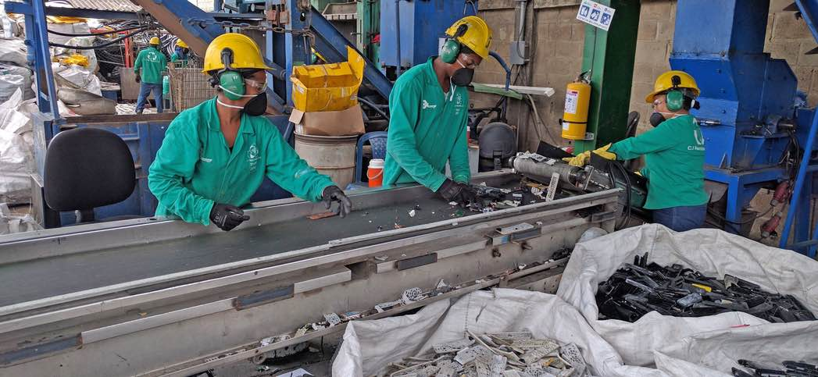
Recycling
shredding
sorting
separated into clean commodities that can be used to make new products

Slide 6
ProblemS
Equipment like ovens or cooling equipment are full of toxic chemicals such as lead and ozone destroying substances
often gets mixed with general household waste and ends up leaching toxins in landfill or getting incinerated and poisoning the air.
Efficient separation of materials is very important!!

Slide 7
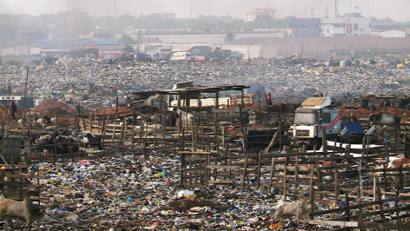
Question
What’s the area of ​​the largest electronic waste landfill in Ghana? (landfill =Mülldeponie)
1 square kilometre?
3 square kilometre?
5 square kilometre?

Slide 8
Sources
https://lenews.ch/2015/04/22/switzerlands-shameful-electronic-waste-record/
https://www.thebalancesmb.com/introduction-to-electronics-e-waste-recycling-4049386
https://en.wikipedia.org/wiki/Electronic_waste#Amount_of_electronic_waste_worldwide

