Slide 1
Grey energy
Matteo & Alex

Slide 2
What is grey energy?
Hidden energy consumption of a product
Twice as much use than direct energy
A lot of people uneducated in this area

Slide 3
Example
People think modern cars need less energy -> only partly true
New cars equipped with:
- GPS systems
- electric windows
-radios
This things need a lot of energy to be produced

Slide 4
How is grey energy calculated?
Extracting and transporting raw materials
Transforming raw materials and manufacturing the final product
Packaging the product
Shipping the product to retailers
Use of product
Collecting and recycling/disposing of the product

Slide 5
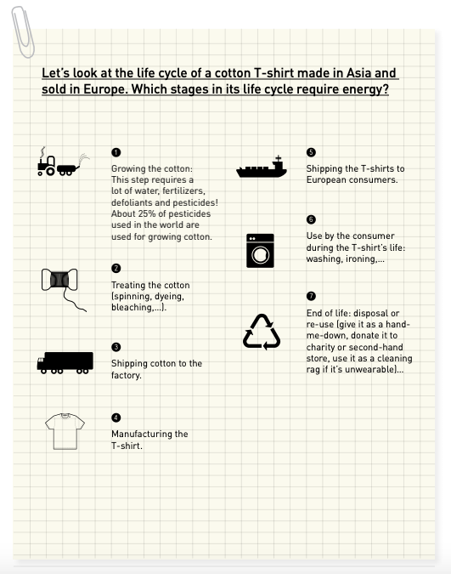

Slide 6
What can we do to reduce grey energy?
We can:
Print documents only when necessary (printing both sides of paper)
Eat less beef
Choose products with little or no packaging
Reuse and recycle products
Buy local and seasonal products

Slide 7
Question
How much from the whole energy used is grey energy?
  50 %
  75 %
  66 %

Slide 8
Thank you for your attention

