Slide 1

Reduce of plastic use
Nina and Luana

Slide 2
Topics
Basic facts about plastic!
How can we improve our daily habits of plastic use?
Recycling options?

Slide 3
Basic facts about plastic!
many different plastics
they are soft and easy to turn into many different forms during manufacture
Plastics are synthetic, human-made materials, made from polymers, which are long molecules built around chains of carbon atoms

Slide 4

How can we improve our daily habits of plastic use?
Stop using plastic straws, even in restaurants.
Use a reusable produce bag
Give up gum
Buy boxes instead of bottles
Purchase food, like cereal, pasta, and rice from bulk bins and fill a reusable bag or container
Use a reusable bottle or mug for your beverages, even when ordering from a to-go shop
Notes:
Use a reusable produce bag: A single plastic bag can take 1,000 years to degrade. Purchase or make your own reusable produce bag and be sure to wash them often!
Give up gum: Gum is made of a synthetic rubber, aka plastic.
Buy boxes instead of bottles: Often, products like laundry detergent come in cardboard which is more easily recycled than plastic.

Slide 5
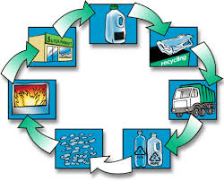
Recycling options?
mechanical recycling
chemical recycling
Notes:
mechanical recycling: ("chop and wash"), where the plastic is washed, ground into powders and melted
chemical recycling: where the plastic is broken down into basic components. Before recycling, most plastics are sorted according to their resin type

Slide 6
Question
Why is it important to reduce the use of plastic?
  A) To save money
  B) To save the environement
  C) To harm green peace

