Slide 1
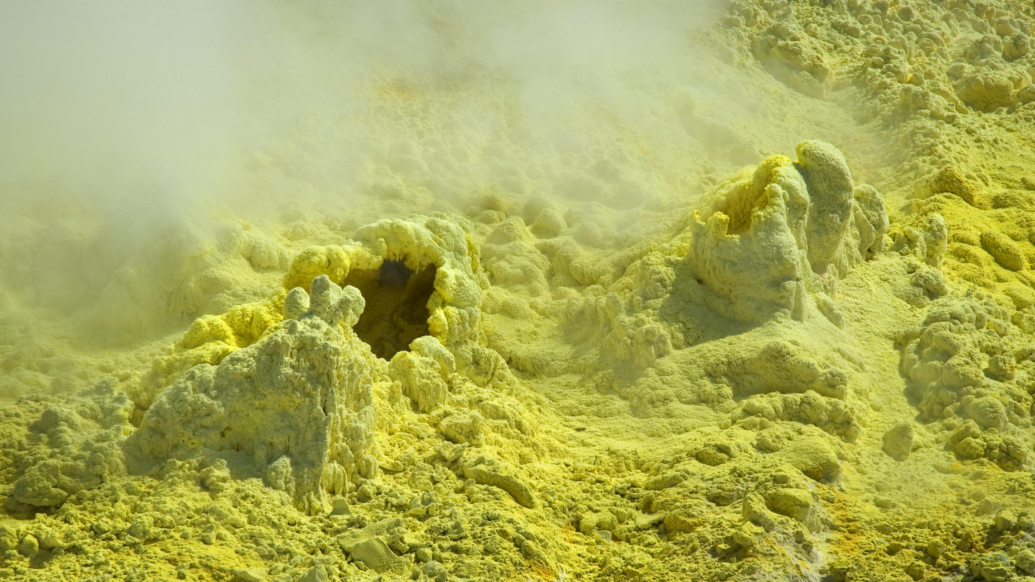
Sulfur/Schwefel

Slide 2
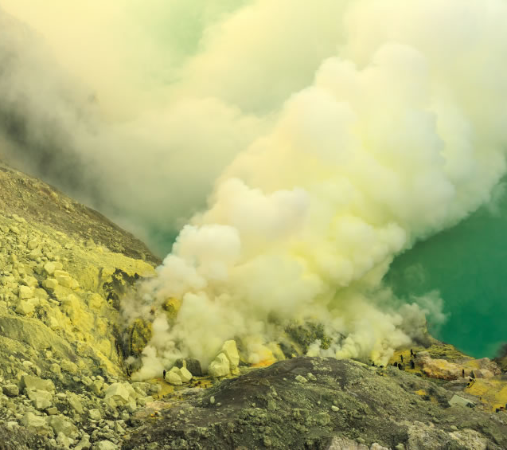
Breakdown of sulfur
Sicilly, Irak, Iran, Mexico, Indonesia
Mostly near volcanos
Acid lakes
Volcano mines

Slide 3
How dangerous is the extraction of sulfur
The gases are highly toxic
Lack of equipment for the workers
Life expectancy is at 50 years
Impaired sense of smell and problem with the lungs
Essential mineral for the human body

Slide 4
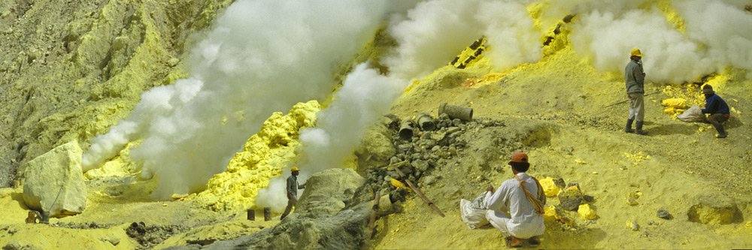

Slide 5
Use of sulfur
Chemical fertilizer
Medication for skin diseases
Matchsticks and lighter

Slide 6
What is deadly for humans?
consumption of pure sulfur
hydrogen sulfide / Schwefelwasserstoff
sulfur acid/ Schwefelsäure

Slide 7
What is deadly for humans?
hydrogen sulfide

