Slide 1
Urban mining

Slide 2
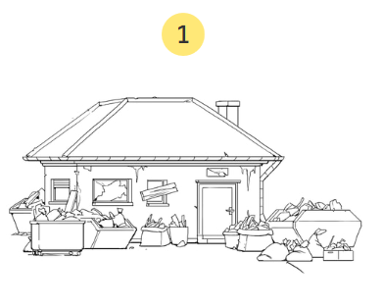
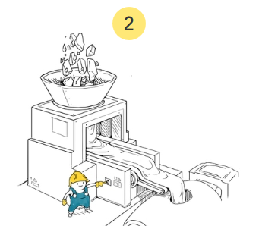
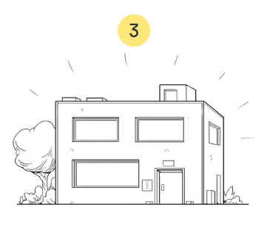
What is urban mining?
building rubble = Bauschutt

Slide 3


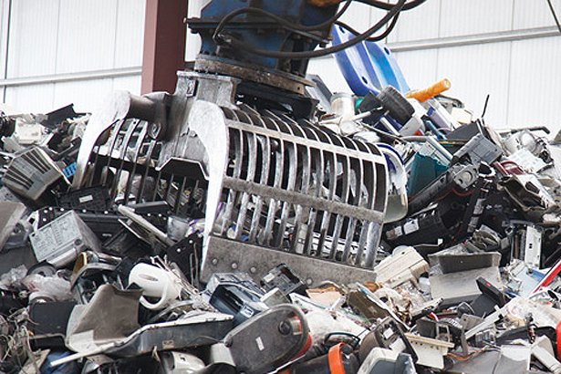
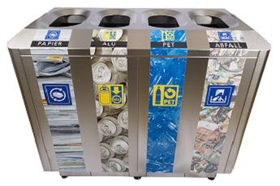
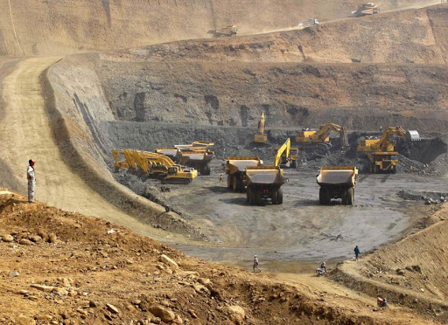
What is urban mining?
Recycling of a mixture made out of different substances
Similar methods like the extraction of resources from rocks
  → why it’s called “mining”
extraction of resources = Gewinnung von Rohstoffen

Slide 4
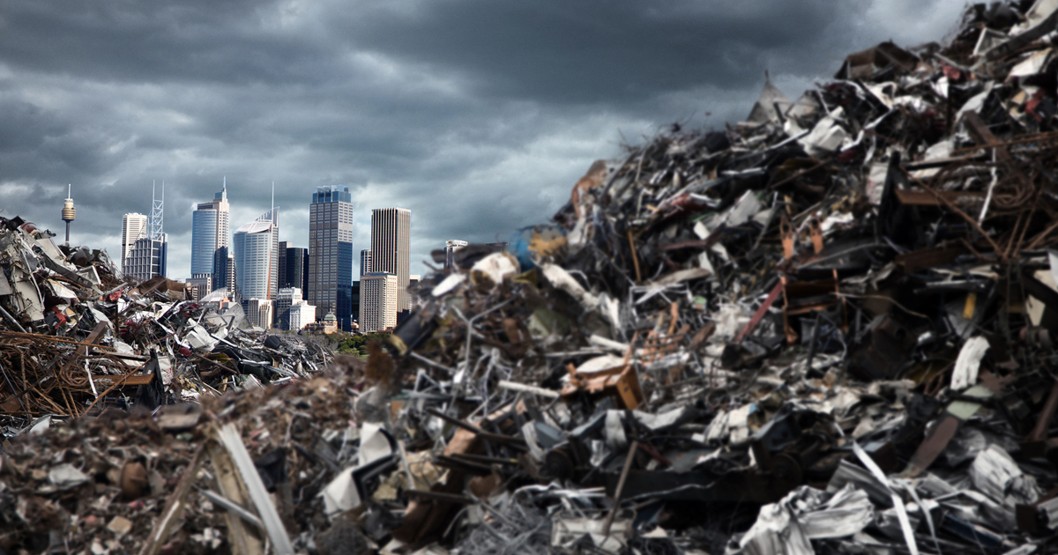
Good to know
7.5 tons silver and 300 kilograms gold → Swiss waste incineration plants
  Nowadays half of the silver and two thirds of the gold can be recovered
City area of 34 km² contains about 2.2 Mio. tons of raw materials
waste incineration plants = Kehrichtverbrennungsanlagen
recovered = wiedergewonnen
raw materials = Rohstoffe

Slide 5
Summary
Less harmful for environment than primary mining
Technologies still not fully developed
primary mining = Erstgewinnung

Slide 6
Quiz
What is NOT associated with urban mining?
A) Trying to reduce the waste that ends up in waste incineration plants
B) Environmentally friendly way of producing materials
C) Process of recycling a mixture of different substances

Slide 7
Thank you for your attention! ☺

