Slide 1

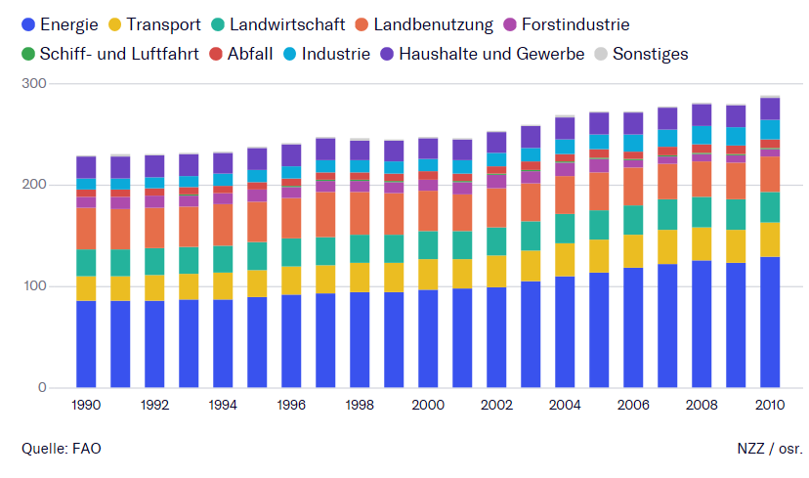

Slide 2


Cars
Amount of cars worldwide in 2019: 1,6 billion.
Cars are responsible for 15 % of the whole CO2 emission.
Forecast in 2050: 60 % CO2 emission.
Problem: Won’t be less traffic in the future.

Slide 3


Planes
45 Mio. planes/year.
Planes are responsible for 15 % of the whole CO2 emission.
Problem: Tickets are too cheap, Kerosin emits CO2
Notes:
Im sure, most of you have already travelled by plane.
2018 über 45 Mio (alles)

Slide 4
Solution:
Hydrogen engin
Hyundai already has prototypes.
We need to put our focus on the progress in this technology.
Teleportation machine
Notes:
Both have caused Co2-emissions but what causes more and how can we reduce it?
Begrüssung

