Slide 1
Plastic waste
From Nicole & Zeynep
BM VZ19a

Slide 2
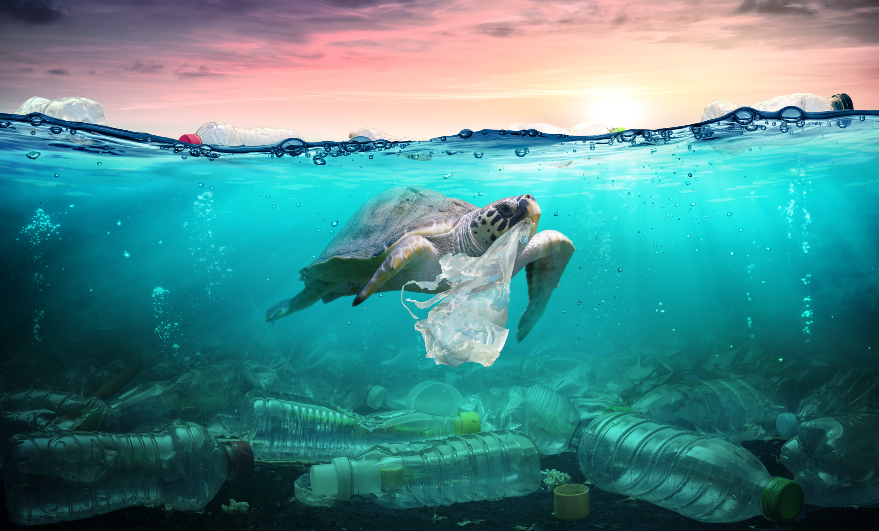
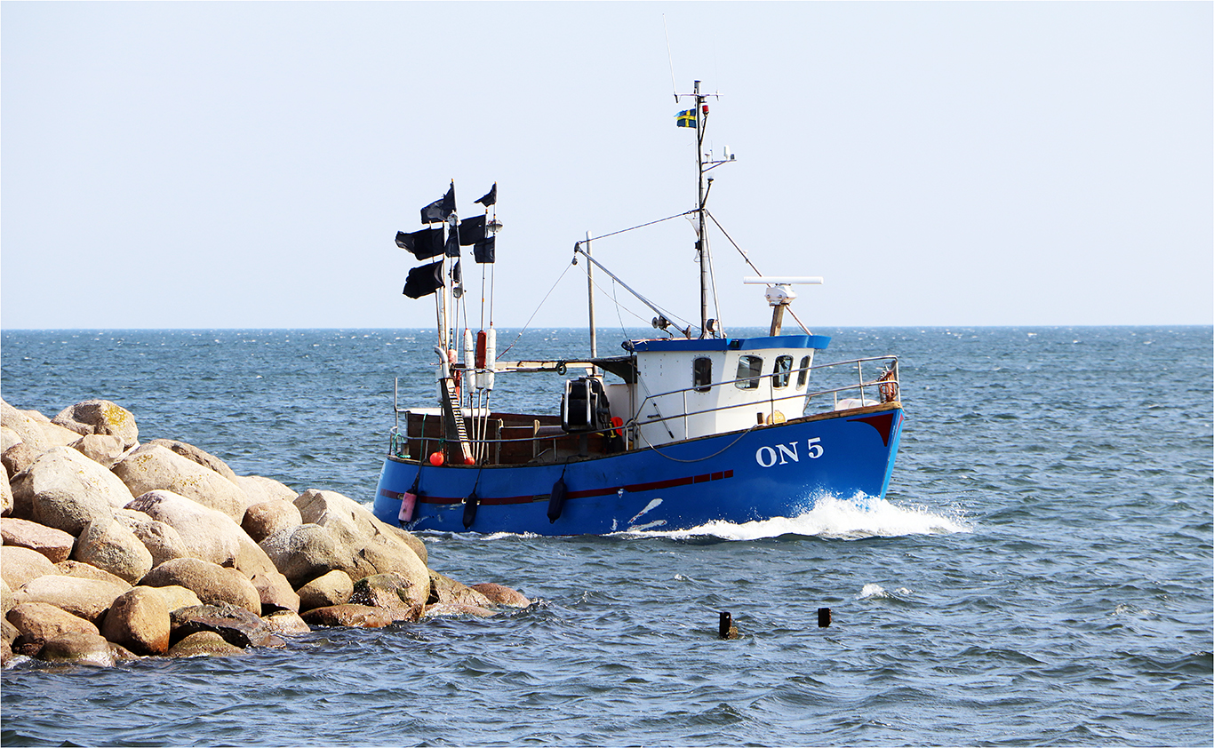
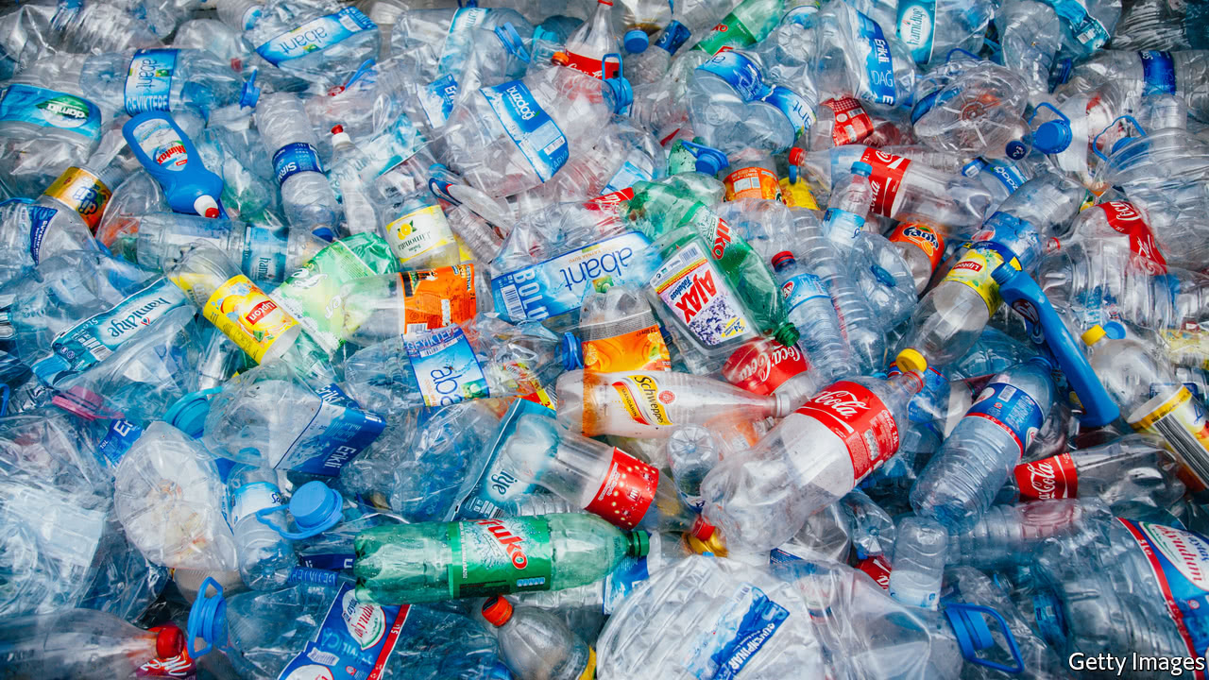
What is plastic?

Slide 4
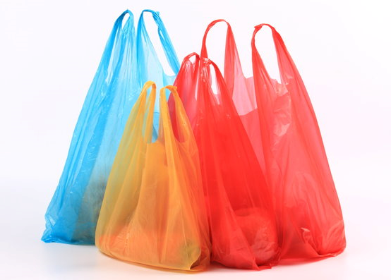
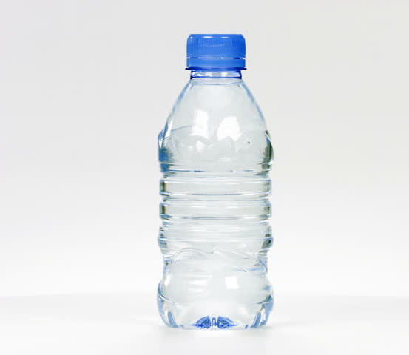
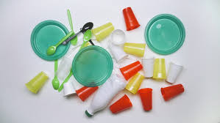
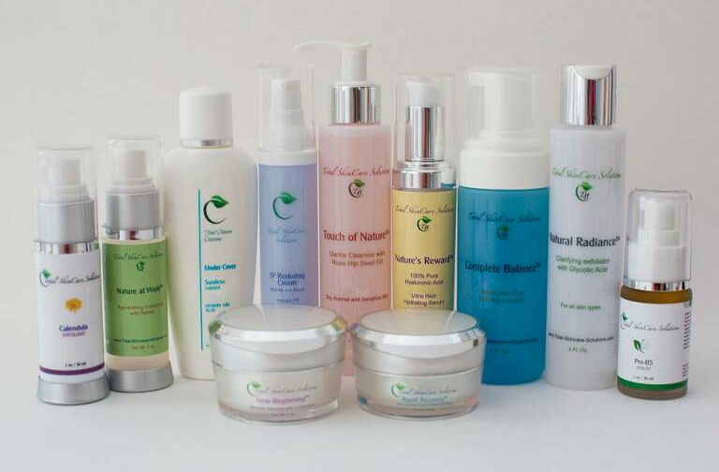
4 ways YOU can cut down using plastic

Slide 5

How many types of plastics are there?
200’000
1 Million
No exact number

Slide 6
Short video
https://www.youtube.com/watch?v=zvzj8Su81g8

Slide 7
Thank you for your attention!

